Slide 1
SOLID Design Principles
Instructor: Mehroze Khan

Slide 2
SOLID Principles
Good software systems begin with clean code
The SOLID principles tell us how to arrange our functions and data structures into classes, and how those classes should be interconnected
The goal of the principles is the creation of mid-level software structures that:
Tolerate change
Are easy to understand
Are the basis of components that can be used in many software systems
The term “mid-level” refers to the fact that these principles are applied by programmers working at the module level.

Slide 3
SOLID Principles
SRP: Single Responsibility Principle
OCP: Open-Closed Principle
LSP: Liskov Substitution Principle
ISP: Interface Segregation Principle
DIP: Dependency Inversion Principle

Slide 4
ISP-Interface Segregation Principle
Segregation means keeping things separated, and the Interface Segregation Principle is about separating the interfaces.
The principle states that many client-specific interfaces are better than one general-purpose interface.
Clients should not be forced to implement a function they do not need.

Slide 5
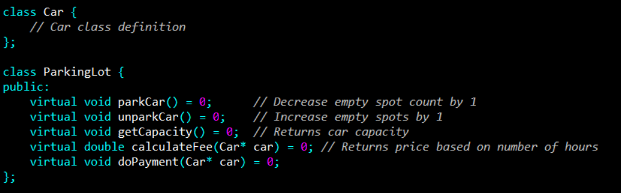

Slide 6
We modeled a very simplified parking lot. It is the type of parking lot where you pay an hourly fee.
Now consider that we want to implement a parking lot that is free.

Slide 7
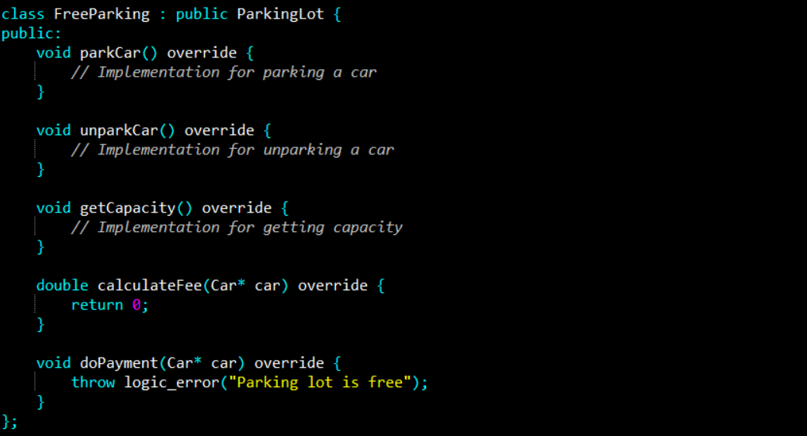

Slide 8
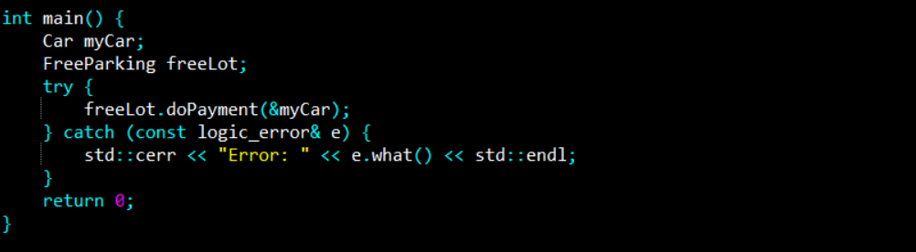

Slide 9
Our parking lot interface was composed of 2 things:
Parking related logic (park car, unpark car, get capacity)
Payment related logic (calculate fee, do payment).
Because of class being too specific, our FreeParking class was forced to implement payment-related methods that are irrelevant to it.
Let's separate or segregate the interfaces.

Slide 10
To address the violation of the Interface Segregation Principle (ISP), we need to split the large ParkingLot interface into smaller, more focused interfaces, so classes that implement them are only required to define the methods they need.
The FreeParking class doesn't need the calculateFee and doPayment methods since it's a free parking lot.
To solve this, we can create separate interfaces for operations like parking/unparking, capacity and payment processing.

Slide 11
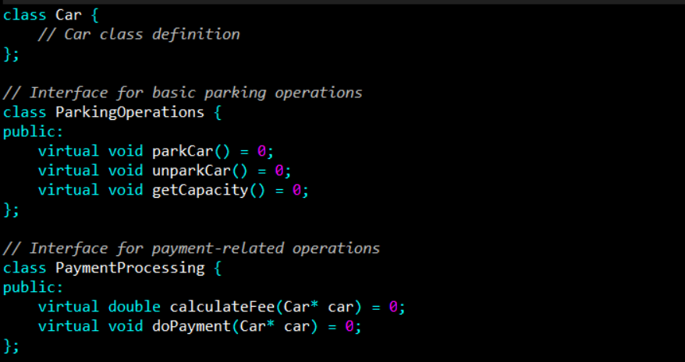
How to fix?

Slide 12
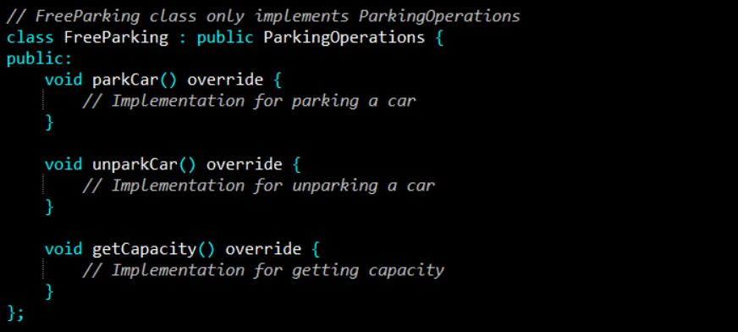
How to fix?

Slide 13
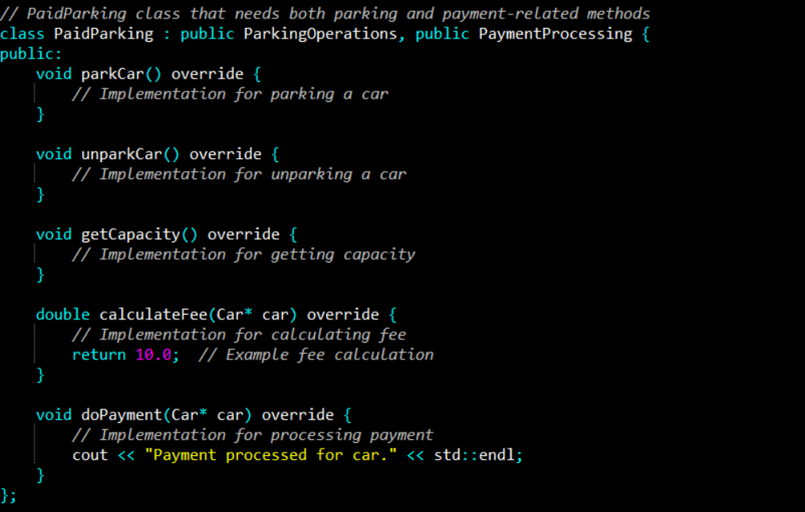
How to fix?

Slide 14
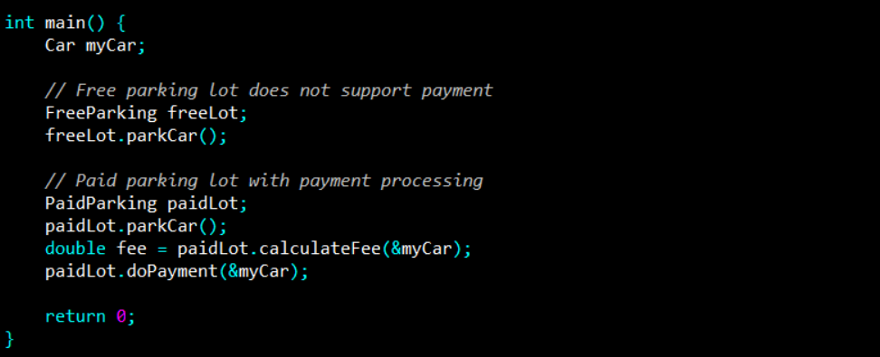
How to fix?

Slide 15
Example
Let’s assume that there is a Restaurant interface which contains methods for accepting orders from online customers, telephone customers and walk-in customers.
It also contains methods for handling online payments (for online customers) and in-person payments.
In-person payments deal with the walk-in customers as well as telephone customers.
Telephone customers pay in-person at the time of order delivery.

Slide 16
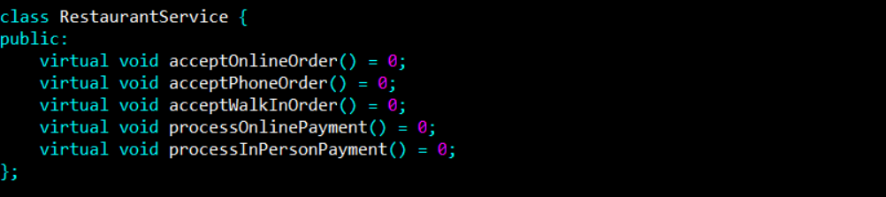

Slide 17
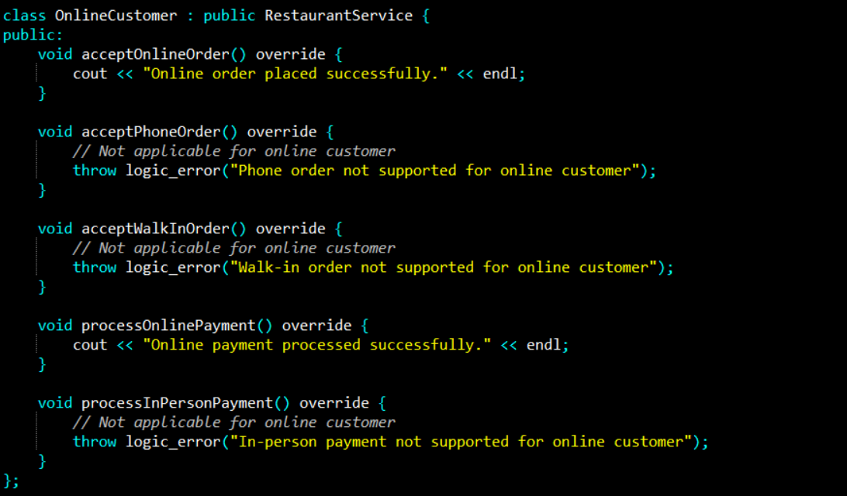

Slide 18
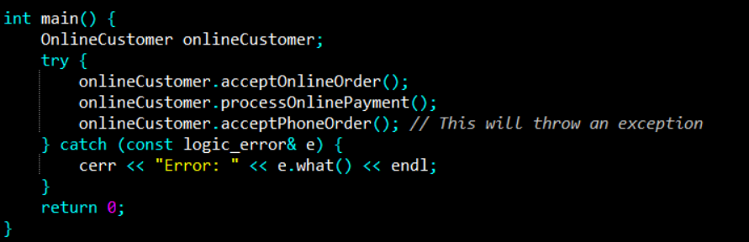

Slide 19
Since OnlineCustomer class is for online customers, we will have to throw Exception for the methods which are not applicable for online customers.
This is also termed as ‘Interface Pollution’. Here we can observe clear violation of Interface Segregation Principle.

Slide 20
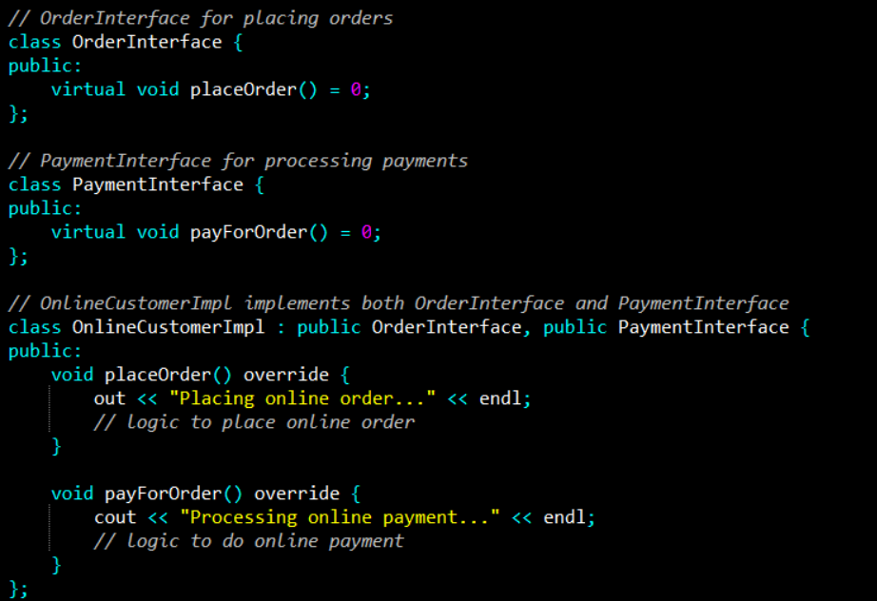
How to fix?

Slide 21
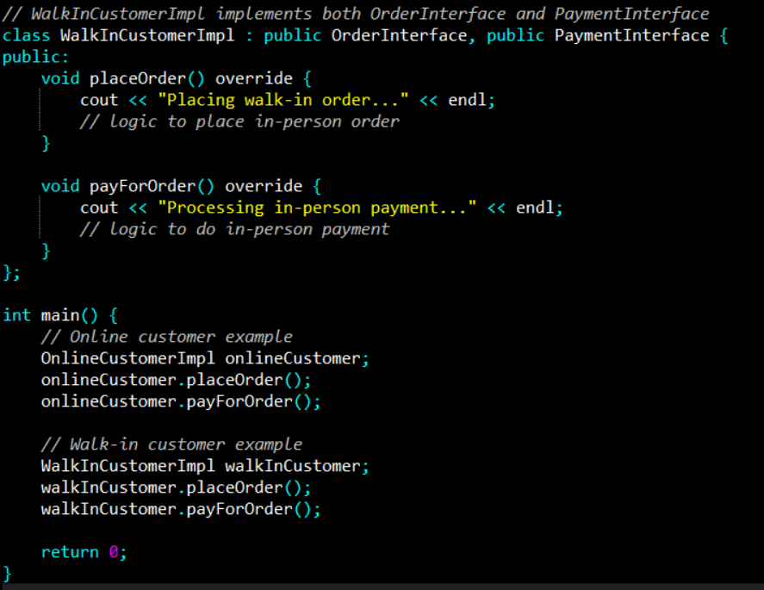
How to fix?

Slide 22
DIP-Dependency Inversion Principle
The Dependency Inversion principle states that our classes should depend upon interfaces or abstract classes instead of concrete classes and functions.
High-level modules should not depend on low-level modules. Both should depend on abstractions (e.g., interfaces).
We want our classes to be open to extension, so we have reorganized our dependencies to depend on interfaces instead of concrete classes.
This helps in achieving loosely coupled systems, making the code more modular, easier to maintain, and flexible for change.

Slide 23
DIP-Dependency Inversion Principle
In the context of the DIP, classes are often categorized as high-level and low-level based on their responsibilities and level of abstraction:
High-Level Class: Deals with the core business logic or the functionality of a system. It focuses on the bigger picture and often relies on lower-level classes to perform specific tasks.
Characteristics:
It is more abstract and less concerned with the technical details of how things are done.
It often orchestrates and coordinates the flow of operations but leaves specific details to other classes.
It represents the overall behavior or the higher-level functionality of the application.

Slide 24
DIP-Dependency Inversion Principle
Low-Level Class: Responsible for more detailed, specific functionality. It deals with the implementation details of a particular task or component of the system.
Characteristics:
It is more concrete and focuses on how something is done (e.g., handling specific input/output operations).
It often performs one specific task and is called upon by high-level classes to fulfill part of the overall functionality.
Low-level classes contain the specific implementations of operations that the high-level classes rely on.

Slide 25
Example
Suppose ClassA depends on ClassB. At runtime, an instance of ClassB will be created or injected into ClassA.
class ClassB {
// fields, constructor and methods
}
class ClassA {
ClassB objectB;
ClassA(ClassB objectB) {
this.objectB = objectB;
}
// invoke classB methods
}
High Level Class
Low Level Class
ClassA
method ()
ClassB
method ()

Slide 26
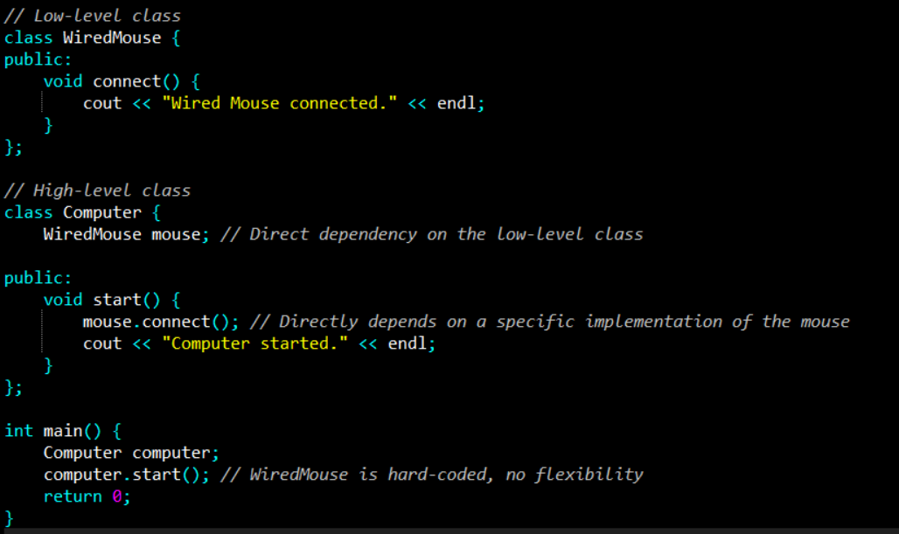
Example (Code Violating DIP)
Notes:
The Computer class directly depends on the concrete WiredMouse class. If we want to switch to a wireless mouse or any other type of input device, we would have to modify the Computer class.
This violates DIP because the high-level Computer class should not depend on the low-level WiredMouse class.

Slide 27
Example
DIP is telling us is to invert the dependency.
The flow of control will still follow the same path. However, now both our objects will depend on the abstraction level of the interface.
Thus, ClassB inverts its dependency on ClassA.
High Level Class
Low Level Class
ClassA
method ()
Interface
method ()
ClassB
method ()
Flow of Control
Flow of Dependencies

Slide 28
Example
interface InterfaceB {
method()
}
class ClassB implements InterfaceB {
// fields, constructor and methods
}
class ObjectA {
InterfaceB objectB;
ObjectA(InterfaceB objectB) {
this.objectB = objectB;
}
...
}

Slide 29
How to fix?
To follow DIP, we can introduce an abstraction (interface) for the Mouse, and the Computer will depend on this abstraction instead of the concrete class.
The actual implementation (wired or wireless mouse) can be provided at runtime.

Slide 30
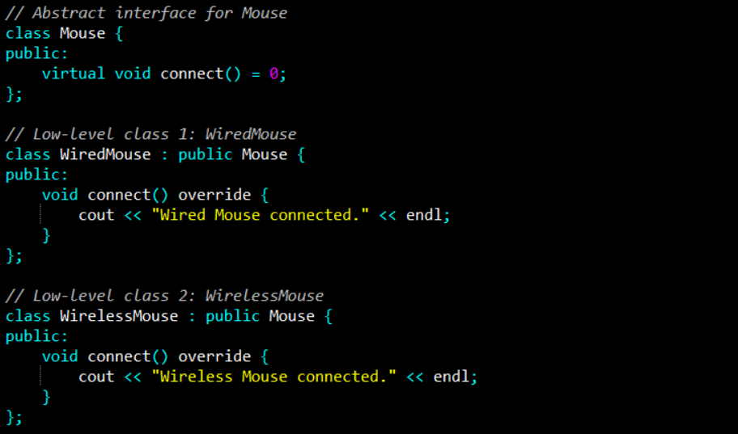
Example (Code Fix)

Slide 31
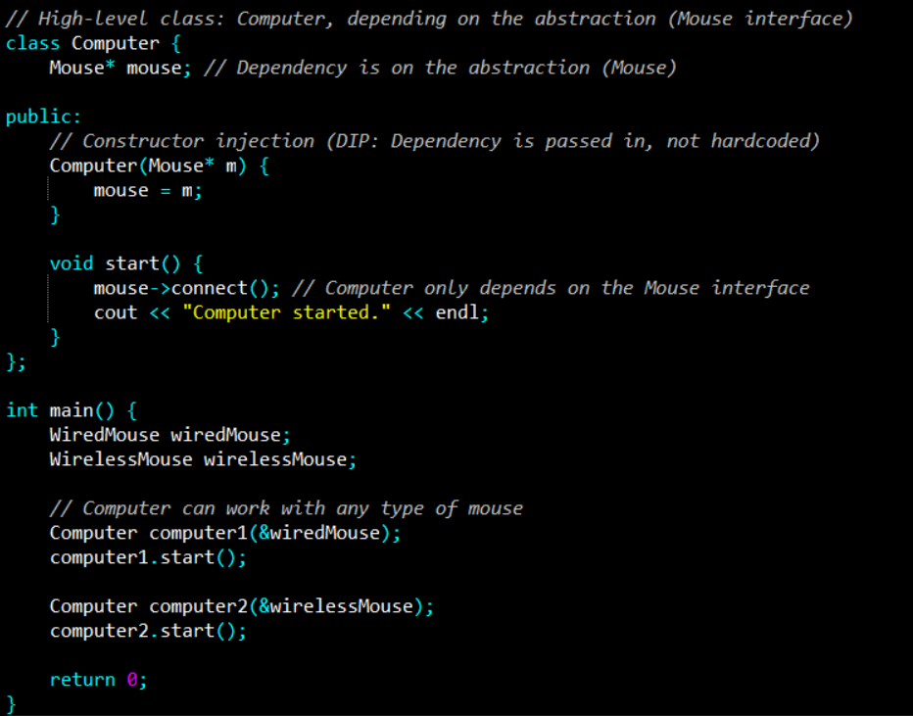
Example (Code Fix)
Notes:
Abstraction Dependency: The Computer class depends on the Mouse interface (abstraction), not on any specific concrete class (WiredMouse or WirelessMouse).
Flexible Implementation: You can easily switch to different implementations of Mouse (e.g., WiredMouse, WirelessMouse) without modifying the Computer class.
Dependency Injection: The specific Mouse implementation is injected into the Computer class via the constructor, making it flexible and decoupled.

Slide 32
Example
Suppose a bookstore asked us to build a feature that enables customers to put their favorite books on a shelf.

Slide 33
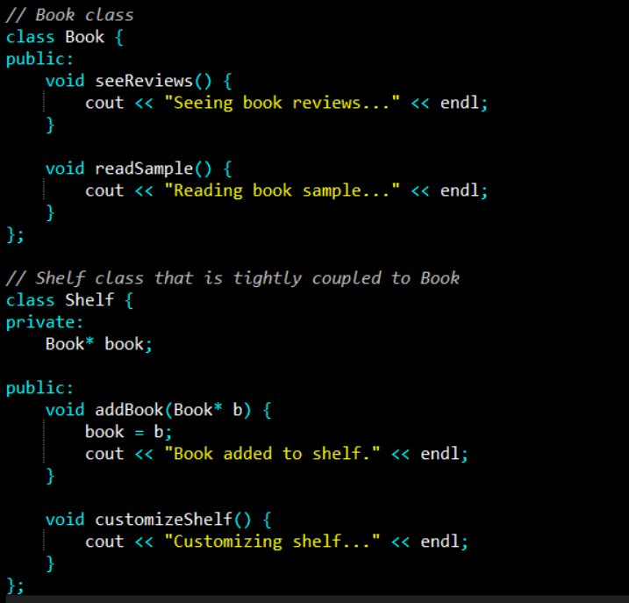
Example (Book Store)

Slide 34
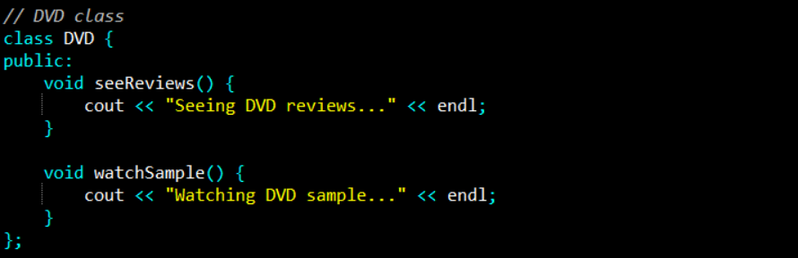
Example Book Store
Store asks us to enable customers to add DVDs to their shelves too.

Slide 35
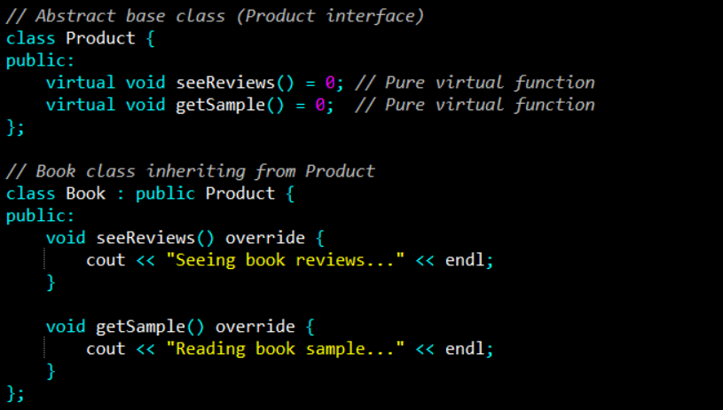
Example (Book Store) Fix

Slide 36
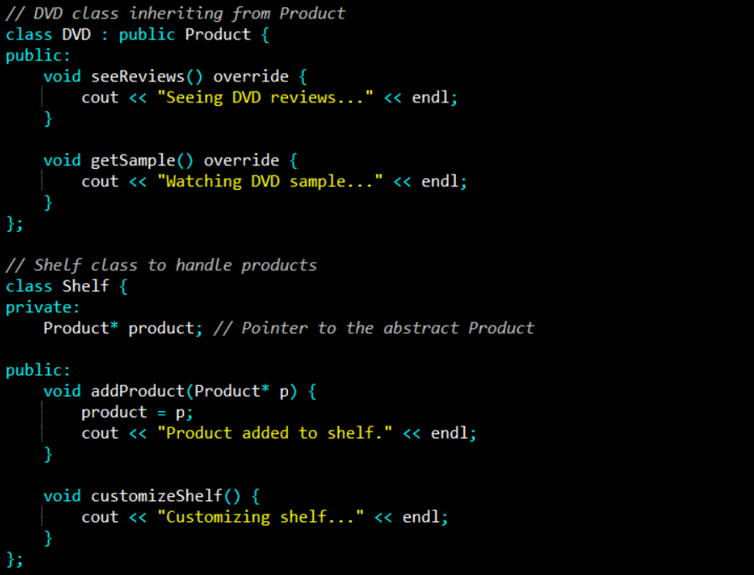
Example (Book Store) Fix

Slide 37
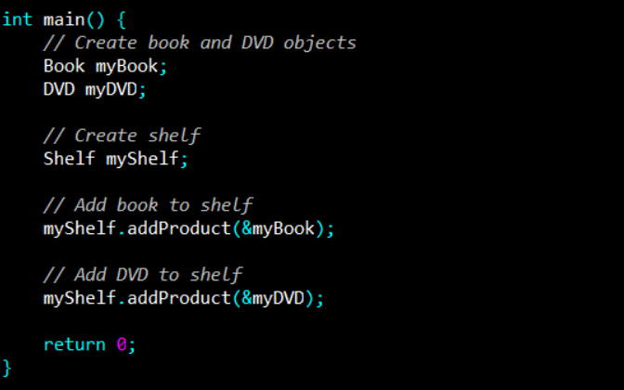
Example (Book Store) Fix

Slide 38
Example
Before
After
Book
seeReviews() readSample()
DVD
seeReviews() watchSample()
Product
seeReviews() getSample()
Shelf
addBook(Book) customizeShelf()
Shelf
addProduct(Product) customizeShelf()
Book
seeReviews() getSample()
DVD
seeReviews() getSample()

Slide 39
References
Clean Architecture: A Craftsman's Guide to Software Structure and Design, 1st Edition, Robert C. Martin, Pearson, 2017.

